Slide 1
Micro-Frontends
Ovvero: come DDD sbarca nella UI

Slide 2








Un grazie agli sponsor

Slide 3





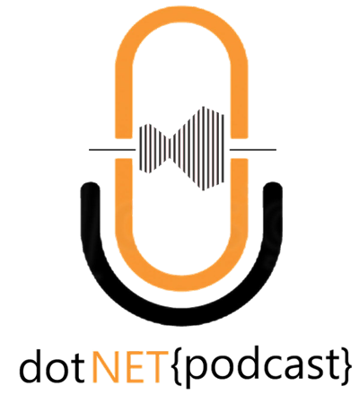


E alle community che ci hanno supportato

Slide 4
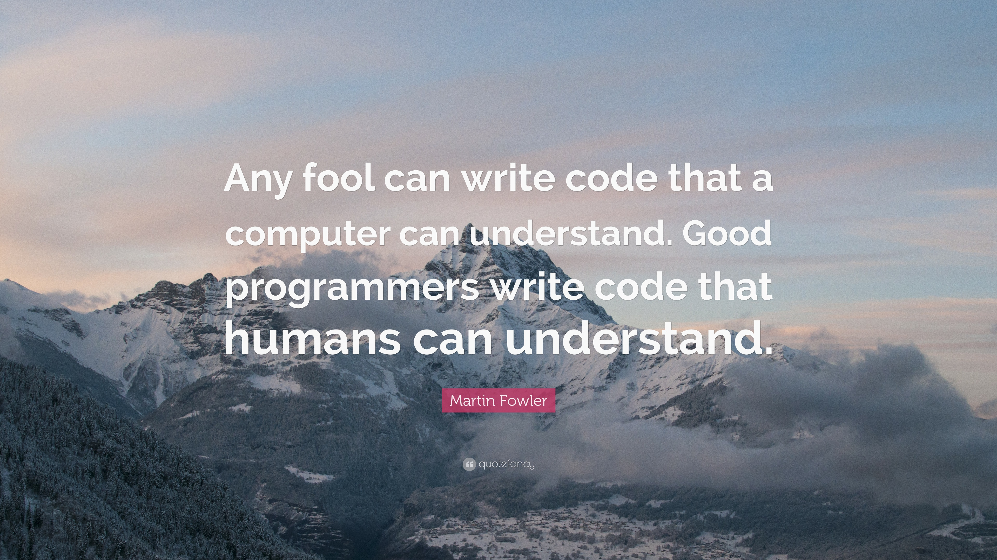
Good Software

Slide 5
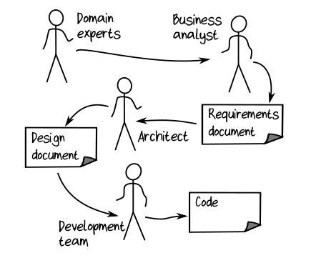
Like Facebook … but better

Slide 6
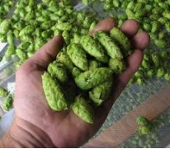



We Like to Brew (and Drink) Beer
Suppliers
Production
Pubs

Slide 7
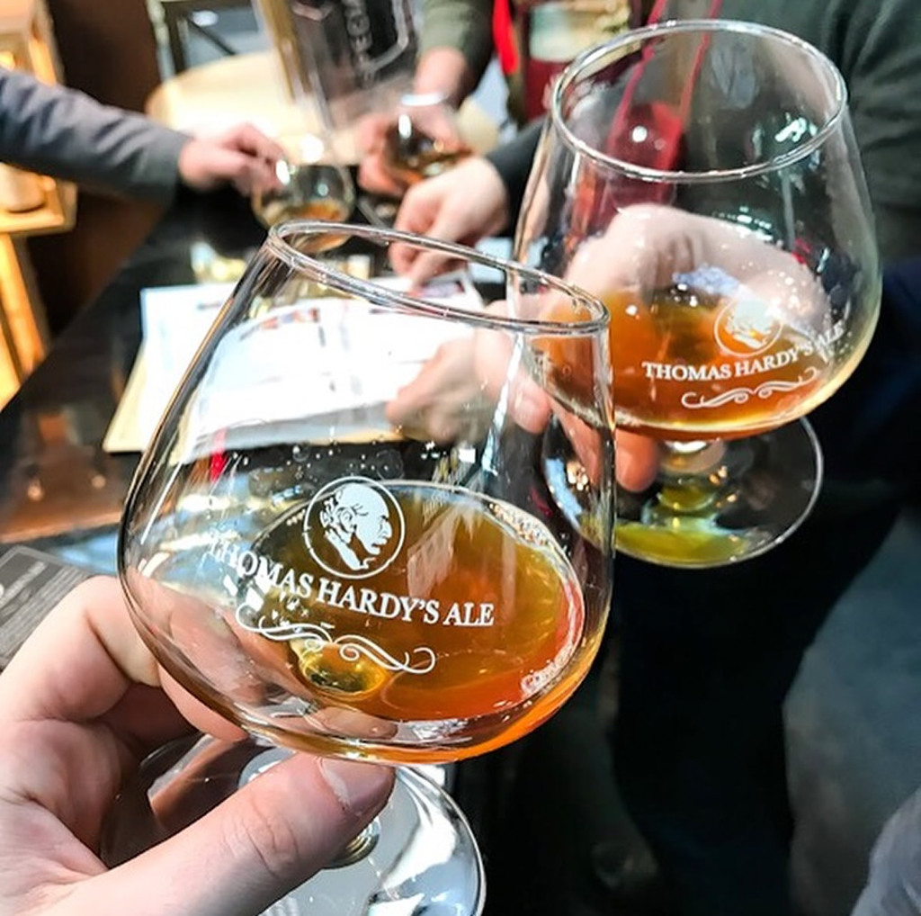
Talk is Cheap … Show me the code

Slide 8
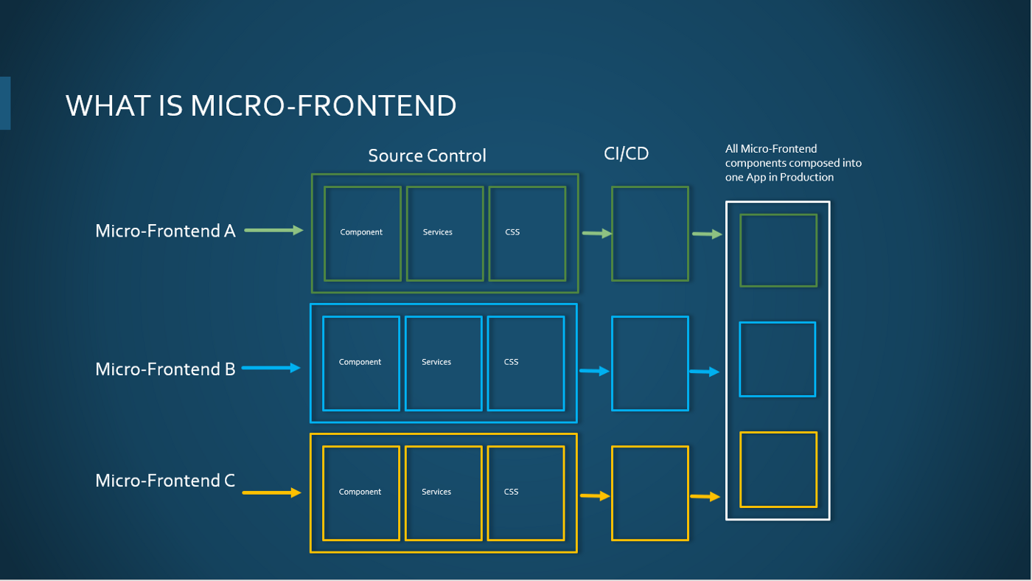
Micro-Frontends

Slide 9

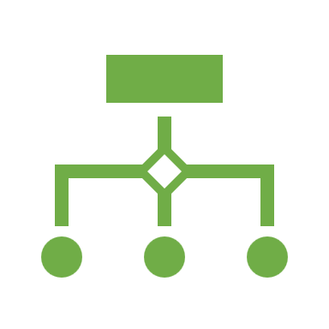
Not a new concept
ThoughtWorks Technology Radar 2016
Self-Contained Systems
- Autonomous Web Application
- Each SCS is owned by One Team
- Asynchronous Communication
- Each SCS has its own API
- Each SCS include Data and Logic
- No Shared UI
- No Shared Business Code
- Shared Infrastructure can be minimized

Slide 10
Decision Framework
Defining what a micro-frontend is in your architecture
Composing micro-frontend
Routing micro-frontend
Communicating between micro-frontend

Slide 11
Micro-Frontends ways
Micro-apps with a shared session and parameters
Routing
Blazor as a component in an existing project
Shared components or a Razor class library
Introduction to Micro-frontends with Blazor web assembly (ifourtechnolab.nl)

Slide 12
What are Micro-Frontends?
Micro-frontends are the technical representation of a business subdomain, they allow independent implementations with the same, or different, technology choices.
Finally they should avoid sharing logic with other subdomains and they are own by a sigle team.

Slide 13

Let me think

Slide 14

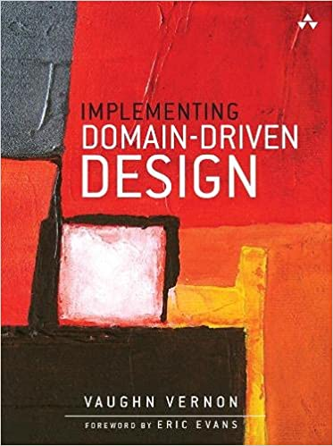

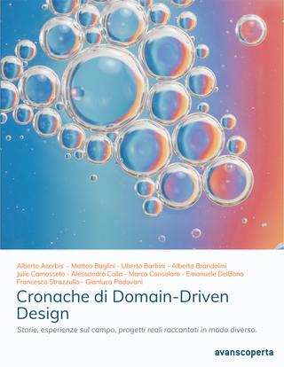
DDD – A bit of story
Tackling complexity in the heart of software
E. Evans – V. Vernon
Qualcuno più vicino a noi …
D. Esposito – A. Santarello
Qualcosa dalla community italiana

Slide 15
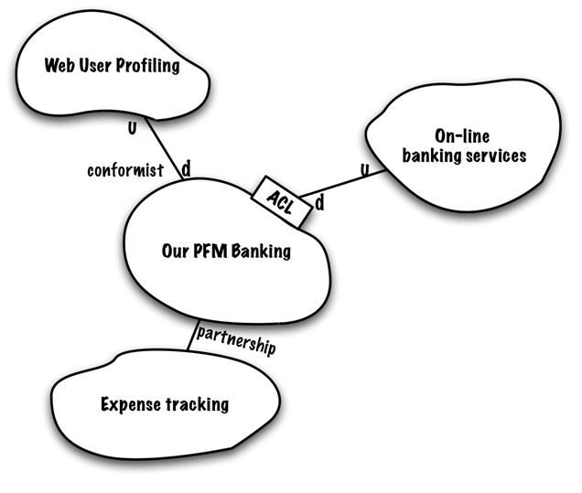
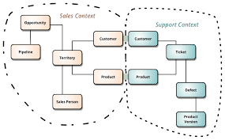
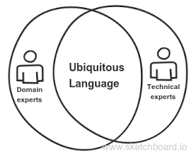
DDD – Strategic Patterns
Context Mapping
Bounded Context
Ubiquitous Language
https://www.infoq.com/articles/ddd-contextmapping/
https://martinfowler.com/bliki/BoundedContext.html

Slide 16
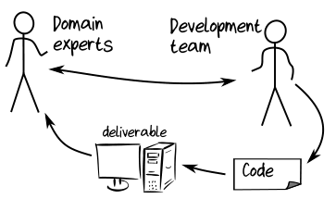
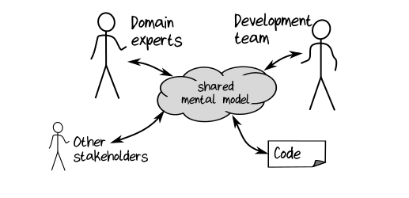
DDD – Shared Model

Slide 17
Talk is Cheap … Show me the code

Slide 18
Bounded Context – Micro-Services – Micro-Frontends
Feature | Bounded Context | Microservices | Microfrontends
Organized around Business Capabilities | It is implicitly understood in the very concept of Ubiquitous Language, which is the main pattern for identifying a Bounded Context | Cross-Functional Teams specific to a business functionality | Each SCS is owned by One Team
Decentralized Governance | A shared model for each purpose | Local choices, which must be independent, are favored/encouraged. | Autonomous WebApp
Decentralized Data Management | Private persistence is critical for language consistency, but especially necessary for the safe and independent evolution of the model | Each microservice must persist its data in a private database! Otherwise, it will be unable to evolve independently from others | Each SCS has its own API Include Data and Logic
Evolutionary Design | Each model can, and must, evolve independent of the others | Key feature | No Shared UI No Shared Business Code Shared infrastructure can be minimized
Smart endpoints and dumb pipes | Recommended as a strategic model | Key feature. SOA docet! | Asynchronous Communication

Slide 19
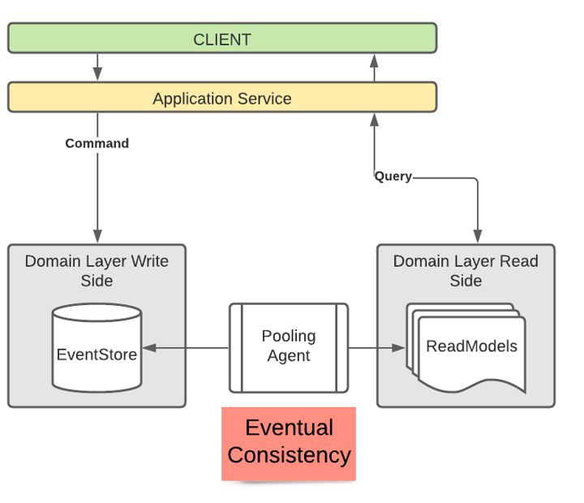
Eventual Consistency

Slide 20







Thank You
Alberto Acerbis
alberto.acerbis@intre.it
@aacerbis
LinkedIn
https://github.com/brewup
https://github.com/cqrs-muflone

Slide 21
Esempio di slide con lista

